Slide 1

Hate Speech Detection Using Machine Learning
Presented by Shreyansh Kumar Jha & Shaunak Chalsey

Slide 2




The Growing Threat of Hate Speech
Hate speech on social media is increasing, leading to online toxicity and real-world consequences. Manual moderation is slow and subjective, making it hard to detect sarcasm, slang, and implicit hate speech. AI models may struggle with bias and context. An automated AI-based solution is needed to improve detection accuracy.
Increasing Hate Speech
Challenges in Detection
The rise of hate speech online necessitates effective solutions.
Traditional methods struggle with nuances in language.
Need for AI
Automated solutions can improve accuracy and efficiency.

Slide 3
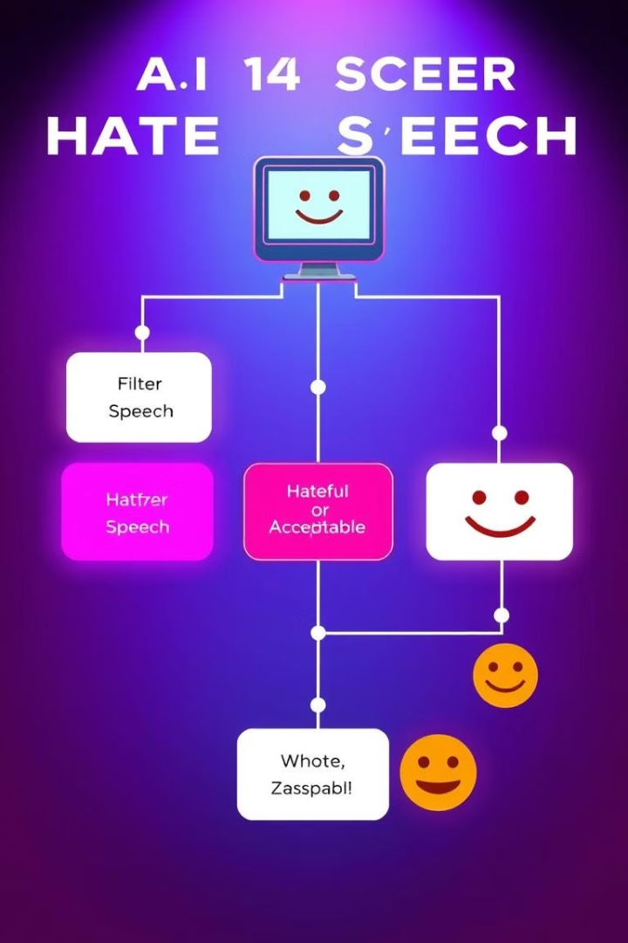
How Machine Learning Can Help
Natural Language Processing (NLP) is used to analyze and classify text. Supervised Learning models (SVM, Decision Trees, Neural Networks) help detect hate speech, while Deep Learning models (LSTM, BERT) improve contextual understanding.
NLP Analysis
Supervised Learning
Analyzing text to identify hate speech patterns.
Using labeled data to train detection models.
Deep Learning
Improving context understanding with advanced models.

Slide 4





Step-by-Step Process
The process involves data collection, preprocessing (tokenization, stopword removal, stemming), feature extraction (TF-IDF, Word2Vec, BERT embeddings), model training & testing (Logistic Regression, SVM, LSTM, and BERT), and evaluation & optimization (Accuracy, Precision, Recall, and F1-score).
Data Collection
Gathering relevant datasets from social media platforms, research papers, and other sources to build a comprehensive training dataset.
Preprocessing
Cleaning and preparing the data by removing irrelevant characters, tokenizing text, removing stop words, and applying stemming techniques to normalize the text.
Feature Extraction
Converting text data into numerical features using techniques like TF-IDF, Word2Vec, and BERT embeddings to represent the text in a format suitable for machine learning models.
Model Training
Training machine learning models such as Logistic Regression, SVM, LSTM, and BERT using the prepared data and features to detect hate speech patterns.
Evaluation
Assessing the performance of the trained models using metrics like Accuracy, Precision, Recall, and F1-score, and optimizing the models for better results.

Slide 5
Findings After Applying Our Approach
ML Models (SVM, Decision Tree) achieved ~80% accuracy but struggled with sarcasm, while Deep Learning models (LSTM, BERT) achieved 90-95% accuracy with better contextual understanding. A hybrid approach improved performance by 6%, reducing misclassification.
80%
90-95%
6%
ML Models Accuracy
Deep Learning Accuracy
Hybrid Approach Improvement

Slide 6
Issues Faced During Implementation
Difficulties include detecting implicit hate speech (sarcasm, coded language), bias in AI models, high computational cost of deep learning, and the challenge of real-time moderation for millions of posts.
Implicit Hate Speech
Bias in AI
Computational Cost
Real-time Moderation
Models may favor specific patterns, leading to misclassification.
Deep learning requires significant resources.
Sarcasm and coded language are difficult to detect.
Processing millions of posts quickly is a challenge.

Slide 7




How to Improve Hate Speech Detection
Improvement strategies include using advanced NLP Models (GPT-4, RoBERTa), developing multilingual AI models, combining text, image & audio analysis, and implementing real-time monitoring on platforms like Twitter and YouTube.
Use Advanced NLP Models
Develop Multilingual AI
Combine Text, Image & Audio Analysis
Real-Time Monitoring

Slide 8




Conclusion & Final Thoughts
AI & ML provide an efficient way to detect hate speech automatically. Deep Learning models outperform traditional ML models in accuracy. Challenges like bias and real-time detection remain, but improvements can be made. AI-powered moderation can help create a safer digital space.
Remaining Challenges
Superior Accuracy
Efficient Detection
Safer Digital Space
2
3
1
4

